Slide 1
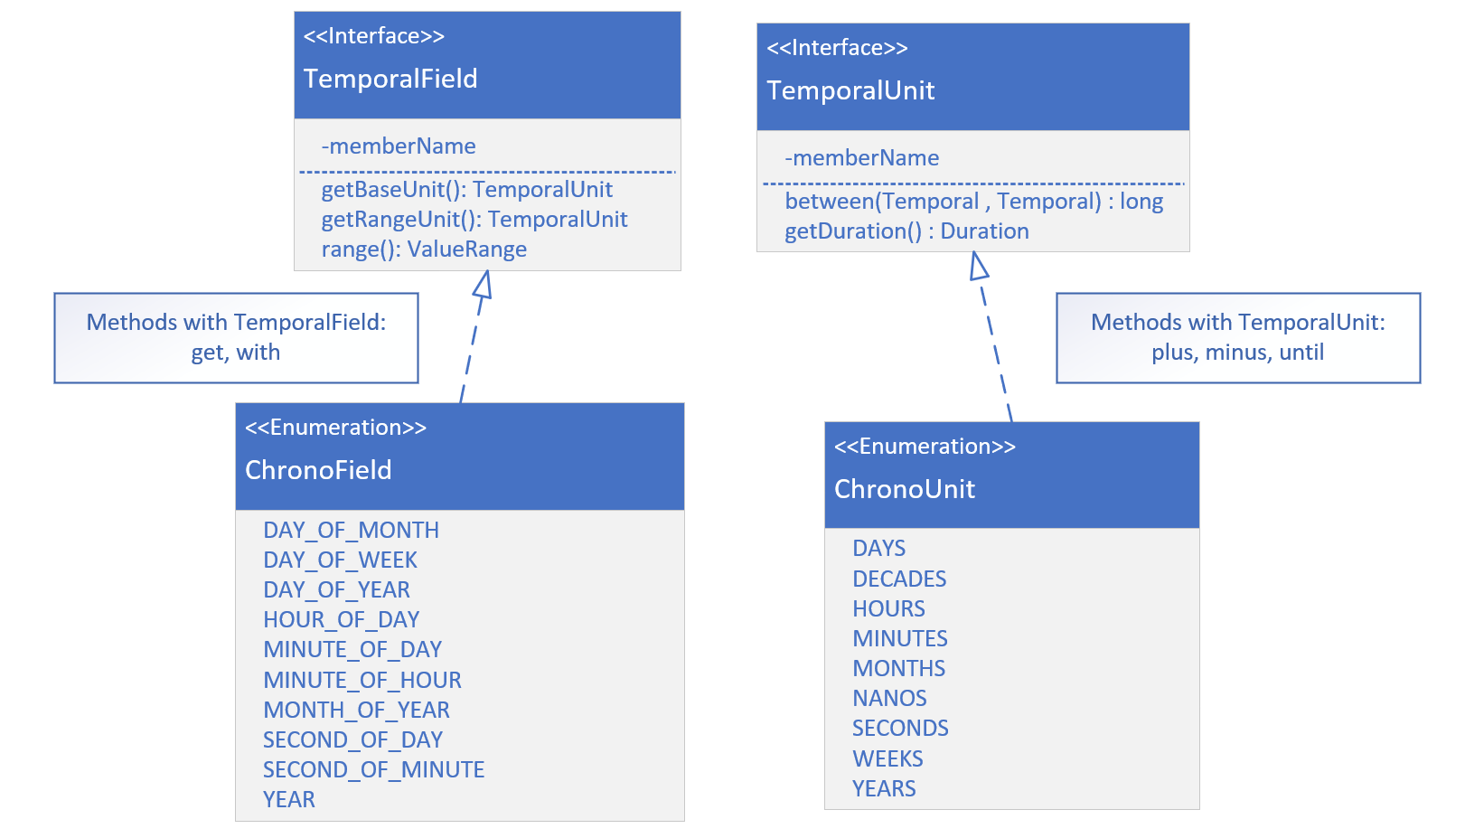

TemporalField vs. Temporal Unit
A temporal field represents a field of date-time, such as month-of-year, or minute-of-hour.
A temporal unit is a measurement of time, such as years, months, days, hours, minutes and seconds.
On this slide, I show both interfaces, and a couple of the methods that would be implemented.
COMPLETE JAVA MASTERCLASS
LocalDate

Slide 2
TemporalField vs. Temporal Unit
I'm also showing you just some of the enum constants on ChronoField and ChronoUnit, ones that are pretty commonly used.
The get and with methods take a TemporalField as a parameter.
The plus, minus, and until methods, take a TemporalUnit.
COMPLETE JAVA MASTERCLASS
LocalDate

